Slide 1
The Power to Transform The Power to Transform Innovation, Guided Pathways and Equity
Presented to the national council on student development
October 13, 2018
Notes:
Please understand that my intention is not necessarily to offend your sensibilities, enrage, diminish or dress down any of you; but if the shoe fits…. My job is to present and your job is to listen. If you finish your job before I finish mine, please snore gently or leave quietly.

Slide 2
Role Confusion
Historical Mission
(Public Good)
Missed Mission (serve and teach how to learn)
Baccalaureate preparation
Skills training
Homemaker friendly
Socialization
Employment
GI Bill
Fed Dept. of Ed vs. accreditors
Evolving Mission
(Individual Benefit)
Baccalaureate awards
Life skills training
Diversity & equity focus
Technology driven
Credential and a job
Financial Aid
Accreditation
Notes:
Mention WW II and need to have re-entry strategy. Describe the shoe salesman story. What do accreditors positions on 4 yr. programs do to college status?

Slide 3
The Future Is here
Historical
Current
Future
Junior College
(socializing and skills focus)
Community College
(transfer and jobs focus)
Community College/4 year programs
Guided Pathway (simplify)
Completion by Design
Certifications
Alternatives
Google, ITunes Univ, Wozniak U, Simulations, AI, Virtual Reality Environments, Amazon
Notes:
How did we get here and do we dig in or adapt?

Slide 4
The Journey
On ground Study
Delivery
Livelihood
Build it and they will come
Students need more choices
(multiple options for maximum performance)
Living wage, entrepreneurs (startups), independent contractors, promotions, career transitions
Notes:
MOOCS, tech hybrids, college on a device

Slide 5
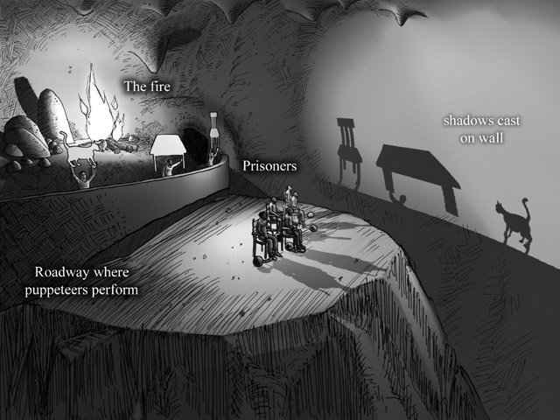
The Practice
Notes:
Higher Education enterprise is the only entity that truly has all the answers, but not the will to fix. Name another entity where 85% of it’s constituents failed in the entity remained solvent. We have professionalized our work to the point we don’t always rely on facts, but rather experience and assumptions.

Slide 6
Environmental Context
Innovation
Equity
Transformation
Context
Barriers
We’ve always done it this way.
The guidelines require compliance
Enablers
Can you solve problems not yet developed
Manipulate tech not yet invented
Transfer skills across career tracks
Diverse perspectives and voices from multiple contributors
Demystify processes and expectations
Solve for systemic and structural inequities
Promote social justice issues
Institutional Will
Colleges of Abundance Theory
Data informed colleges
Technology enabled processes
Autonomous administration
Sense of multiple and unknown possibilities
Guided Questions:
Does this action or decision increase or improve student success; and how do we know?
Establishing a culture of evidence
Data is the new oil
Notes:
We need operational definitions and they need to be universally agreed upon. Church story. Under the guise of equity, should poverty be addressed by colleges/boards. Colleges of Challenge and Choice

Slide 7
Call to action
What did Mother Theresa, Mahatma Gandhi, and Martin Luther King Jr. have in common?
The belief that one person could change the world. Regardless of position or station, you too can change your world.
Begin questioning actions that add little or no value to the student success effort-Ask about the assumptions being fostered-Ask for evidence-Hold yourself accountable-Demand accountability from your colleagues-Do the right thing at the right time, all the time-Use the data to instigate change-Use neuroscience concepts to advance our practices-Make certain innovations are technically advanced and culturally sensitive.

Slide 8
Call to Action 2
Engage students (particularly underrepresented and non traditional students) immediately and consistently. Personally engage students.
Provide the evidence to change or eliminate Developmental Ed
Practice intrusive advisement
Use algorithms and predictive analytics to steer course
Use comparison data to augment/modify instructional practices
Modify cognitive digital assistants (Siri, Alexa) to augment efforts
Co-Create the futures you want for your students

Slide 9
Crucial Questions
Despite all efforts, is our district/college mostly concerned with routine matters or is it brutally clear to enough of us that we must change and do something, now with college completion?
If asked today, what percentage of the district/college employees, including the leaders, would agree that there is a major problem or missed opportunity? Is it high enough?
Are there NoNos in our district/college with the attitude and power to keep people from acknowledging or addressing the problem? What are they doing to undermine our efforts?
Have we assembled the equivalent talents of a visionary guiding team
Does out guiding team work well together or do they need to go for an ice tea
Is our guiding team working on project plans, budgets etc., or are they thinking about "the creation of a change vision and a strategy
Which old rules that are in the way of making change happen need to be bent or abandoned?
How do we pass on the story of our change to the next generation?
Do we have a simple enough message for our change vision to be understood and remembered?
Can we draw a sensible and appealing picture of what our future may look like?
Is our change strategy a set of simple enough logical steps of how this future can be created, so that it has a chance to be understood and be remembered by our colleagues?

Slide 10
Exercise
You are the founding administrator at Futures CC opening in 2030.
Name 3 systems/processes you would implement initially (may not yet exist) and 3 current systems/processes you would eliminate.

Slide 11
References
The Republic, Plato
Athens, Greece AD 380
Achieving the Dream
Silver Spring , MD May, 2017
Community College Research Center
New York, NY 2015
MDRC
New York, NY 2018
Institute for the Future
Palo Alto, CA 2018
Community Colleges on the Horizon
Rowman and Littlefield
Lanham, MD 2009

Slide 12
Contact Information
Andrew C Jones, Ed.D.
Chancellor, Retired
ajone1950@gmail.com
Notes:
God story!

